Slide 1
Zahlen und Fakten zu Europas Migrationsströmen
Zusammenstellung des Ortsverbandes Dinslaken Bündnis’90/Die Grünen

Slide 2
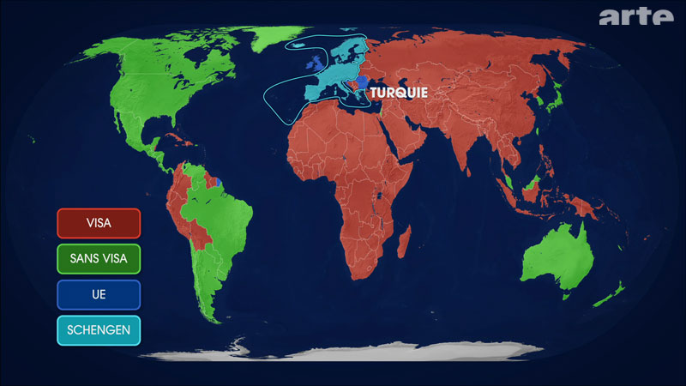

Slide 3
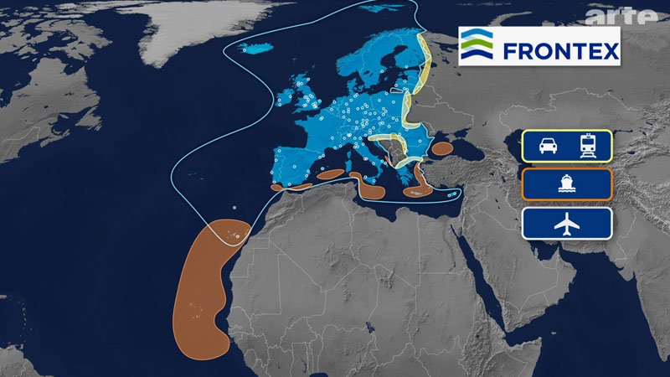

Slide 4
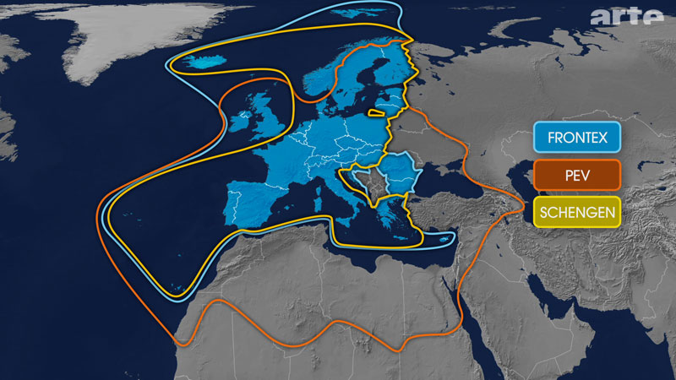

Slide 5
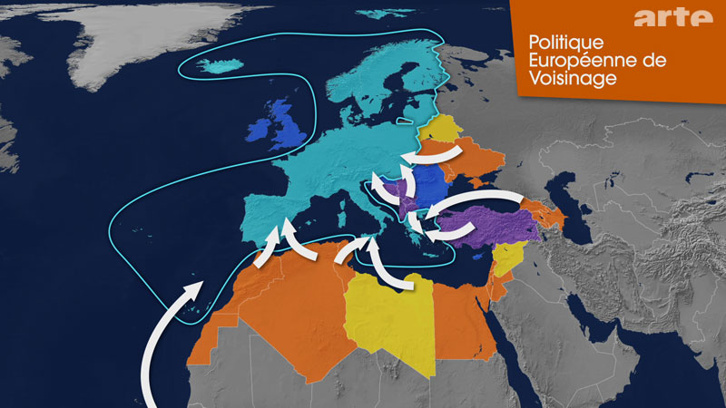

Slide 6
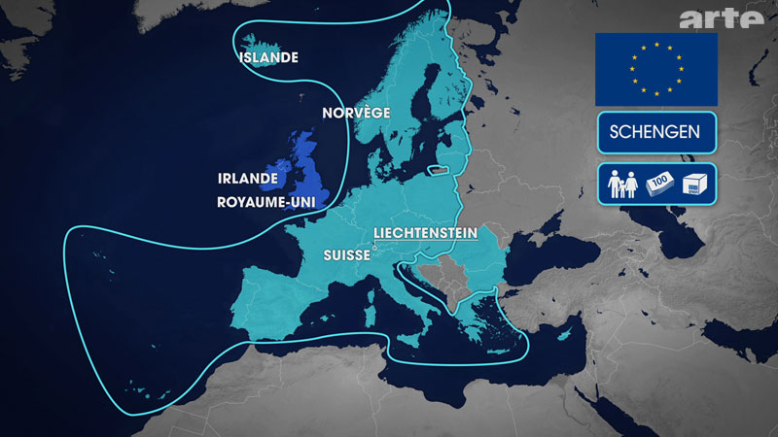

Slide 7
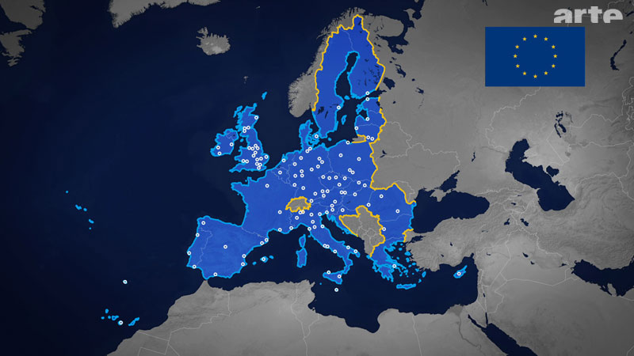

Slide 8
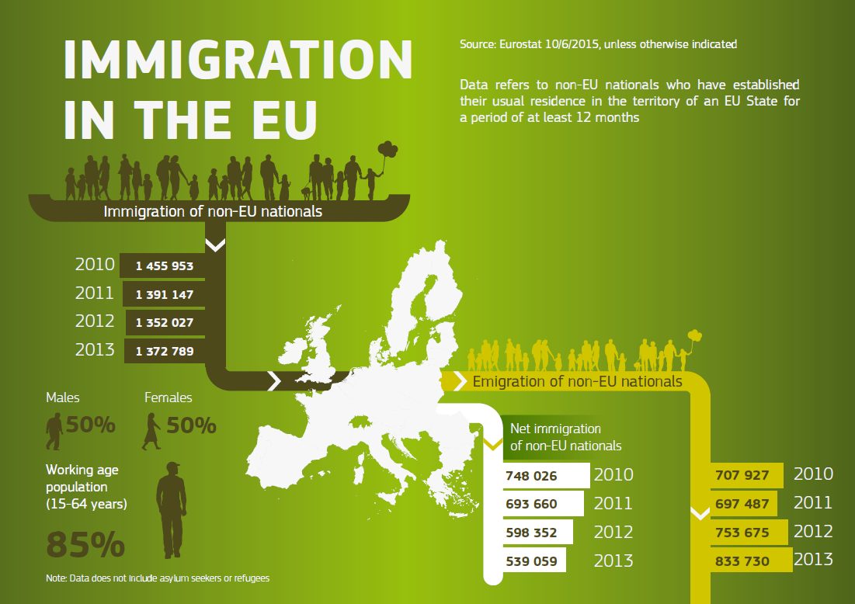

Slide 9
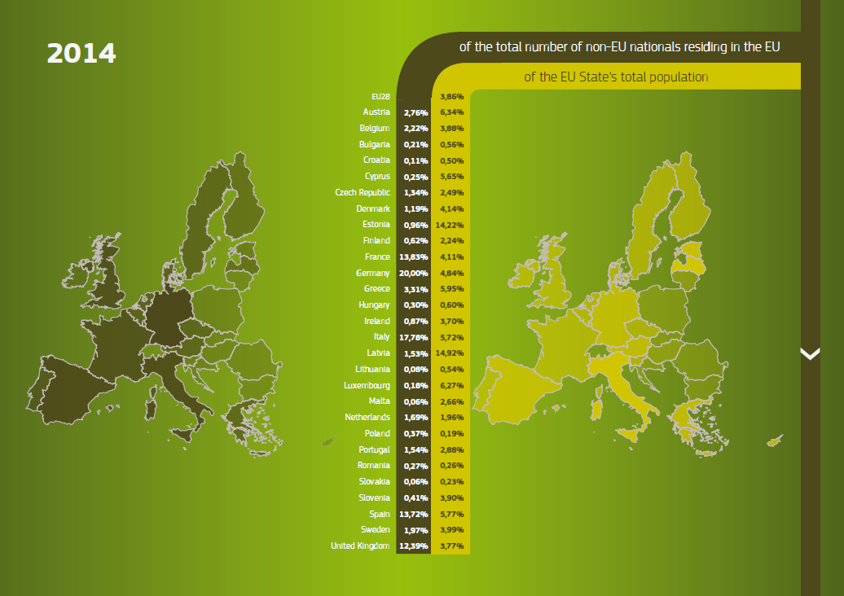

Slide 10
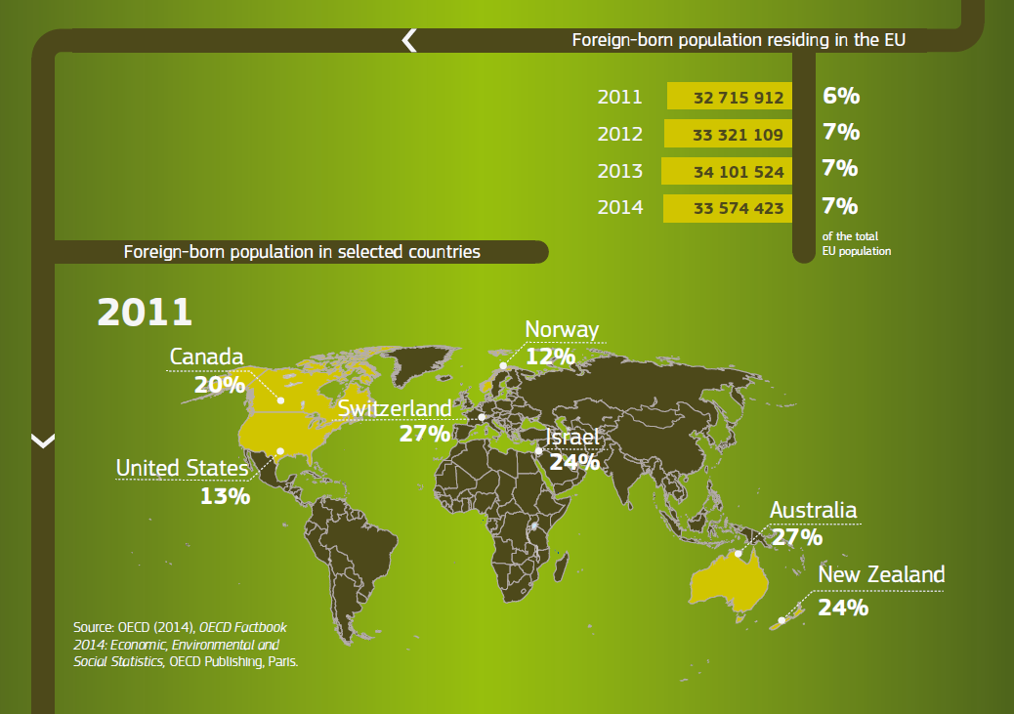

Slide 11
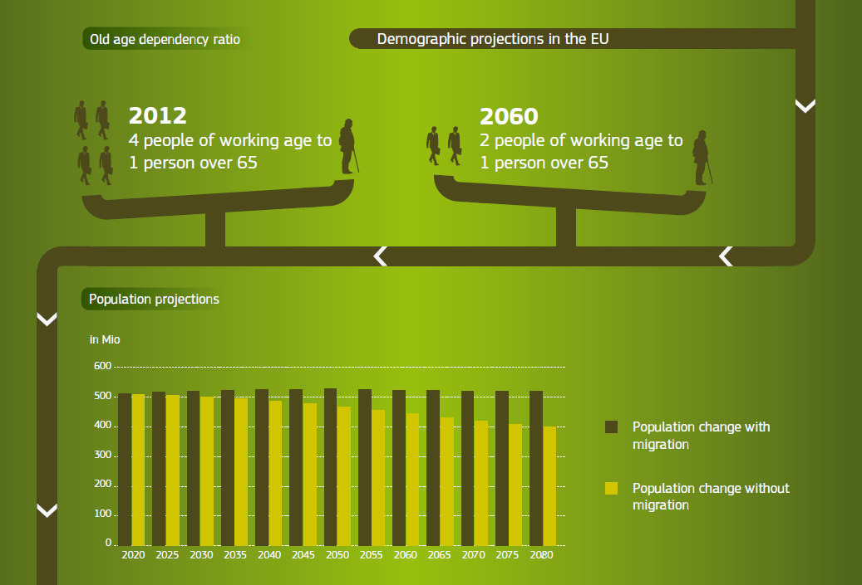

Slide 12
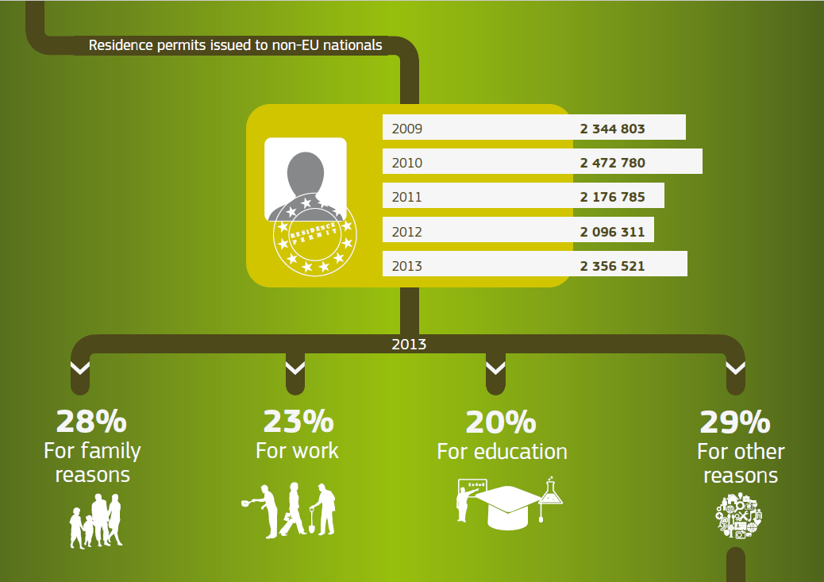

Slide 13
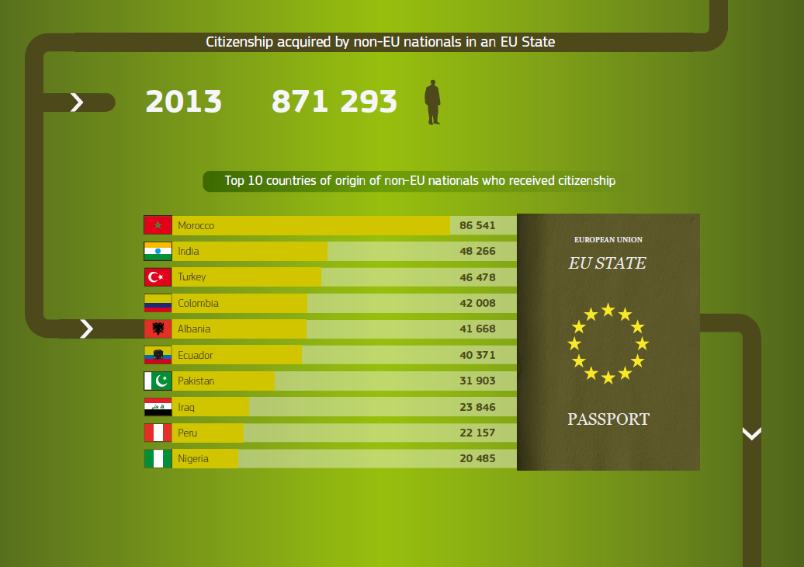

Slide 14
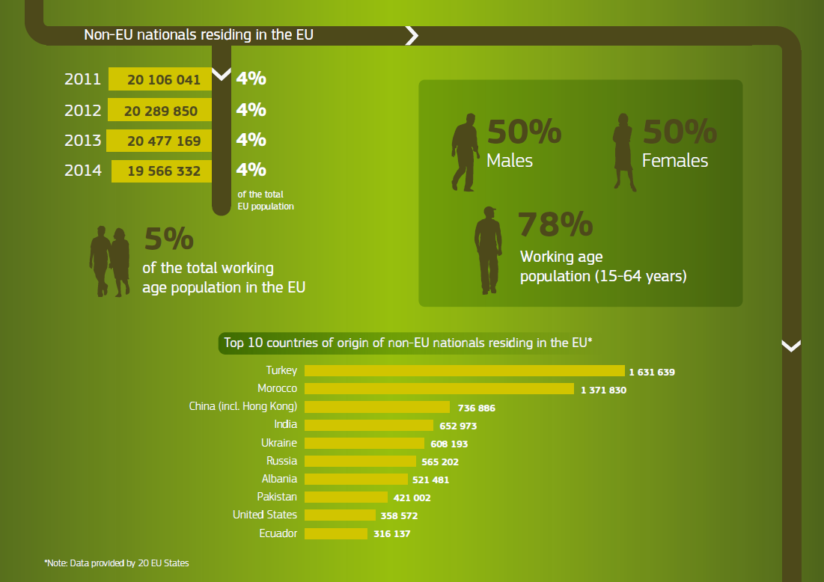

Slide 15
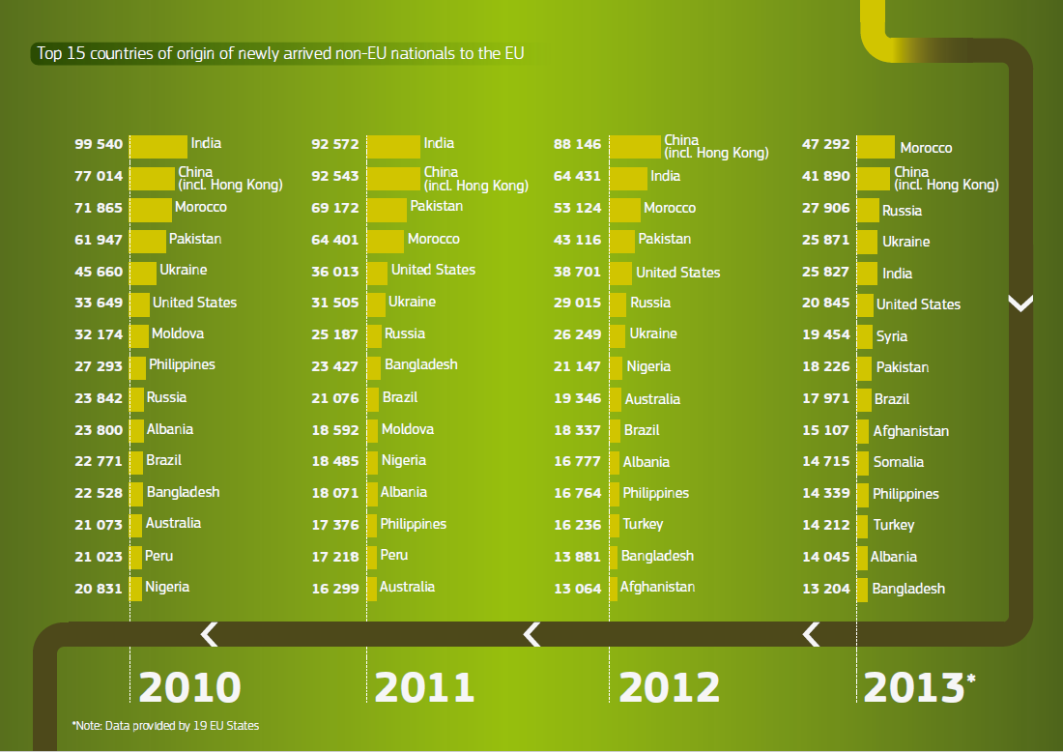

Slide 16
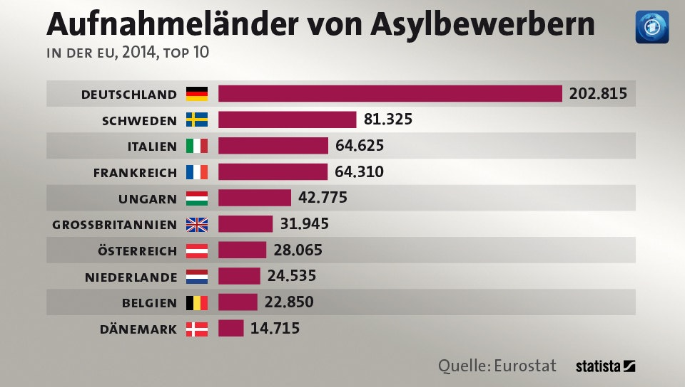

Slide 17
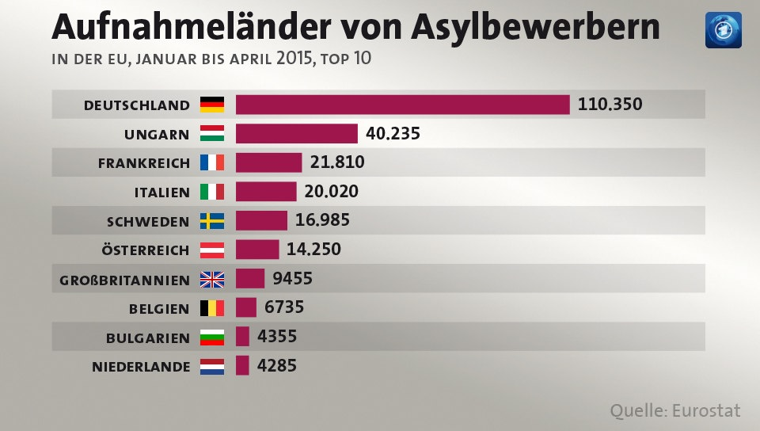

Slide 18
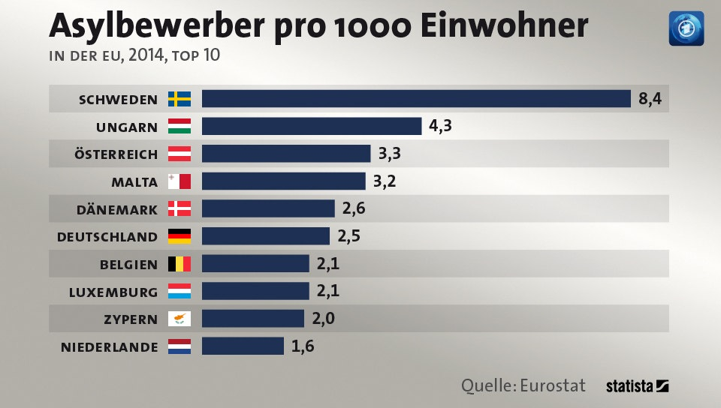
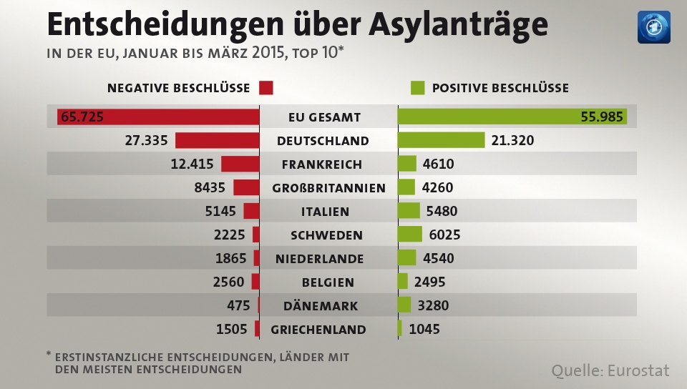

Slide 19
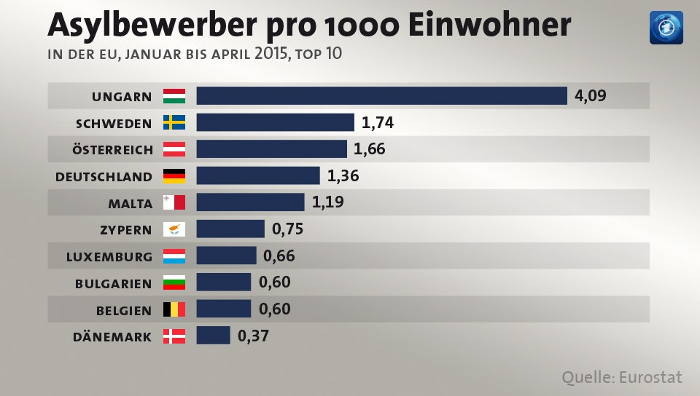

Slide 20
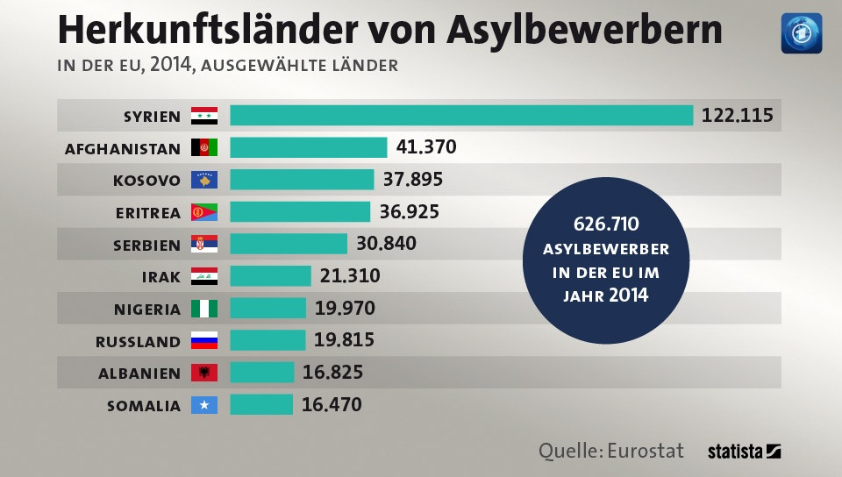

Slide 21
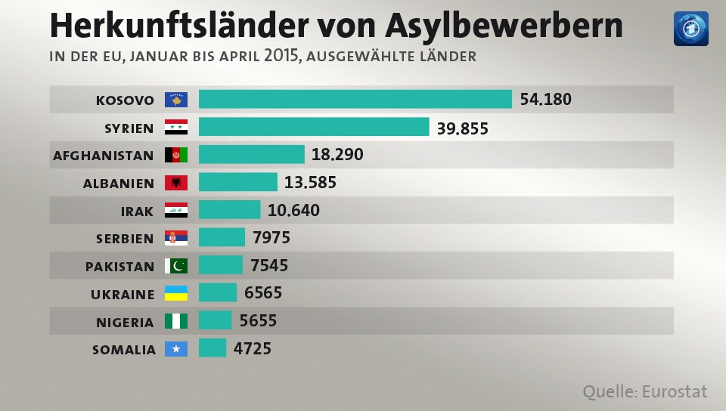

Slide 22
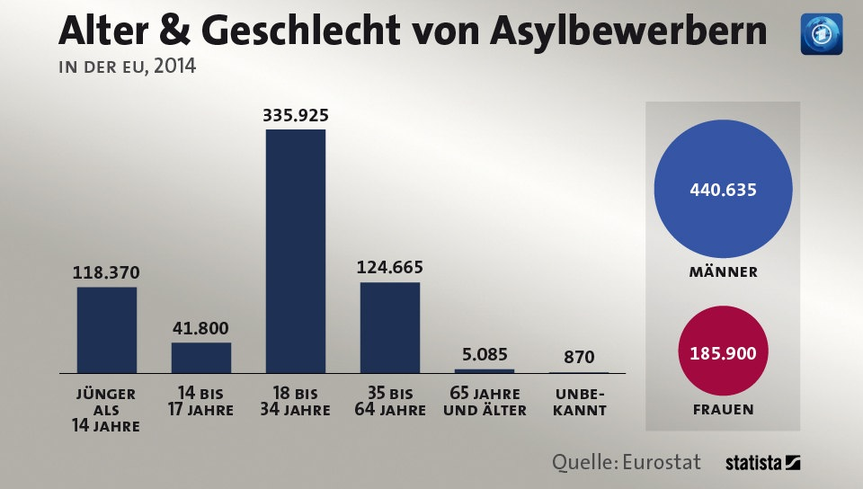

Slide 23
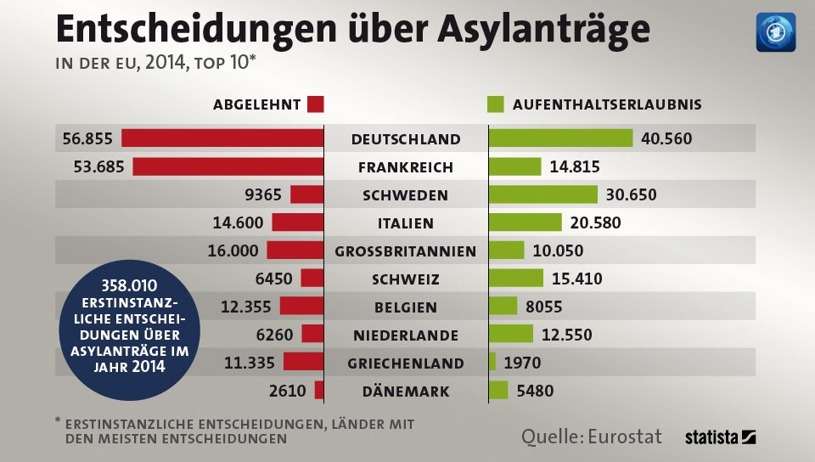

Slide 25
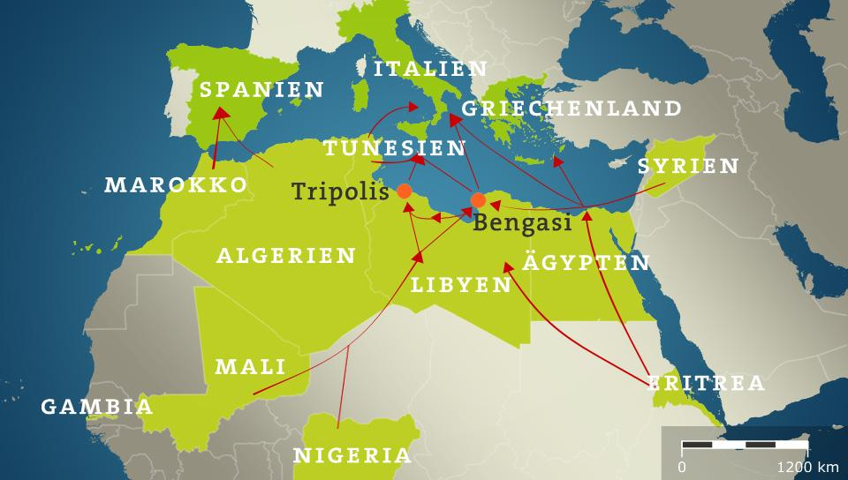

Slide 26
– 03/11/2004 - Bombs on commuter trains in Madrid – 07/07/2005 - Three subway trains and a bus in London – 22/07/2011 - Anders Behring Breivik in Oslo – 02/11/2011 - Charlie Hebdo firebombed in Paris – in 03/2012 - A gunman in Toulouse – 07/01/2015 - Charlie Hebdo massacre in Paris – 22/05/2015 - Lee Rigby in London – 24/05/2015 - Jewish Museum in Brussels – 22/08/2015 -Train from Amsterdam to Paris – 14/11/2015 - Terror Act in Paris
Additional Information

